Slide 1
K Ramakrishnan college of ENGINEERING (autonomous) department of cse
DIGITAL JEWELLRY
GUIDED BY
R. Nalini
Presented by
DHIVYDHARSHINI N(CSA2132)
DIVYADHARSHINI M(CSA2135)
DONA VERGINIYA N(CSA2136)
JANANI SELVI J(CSA2149)

Slide 2
AGENDA
Introduction
How it works?
Components
Functions
The java ring
Advantages
Disadvantages
Conclusion
References

Slide 3
Introduction
Digital jewellry is the fashion jewellry with embedded intelligence. It can best be defined as wireless, wearable computers that allow you to communicate by ways of e-mail, voicemail, and voice communication.
Let’s see how various computerized jewellry will work with mobile embedded intelligence.
The latest computer craze has been to be able to wear wireless computers. Best example red tacton technology, wearable biosensors smart watches etc.
These devices have a tiny processor and unique identifiers that interact with local sensors.

Slide 4
How it works?
Digital jewellry is a new form of mobile.
Jewellry is worn for many reasons -- for aesthetics, to impress others, or as a symbol of affiliation or commitment.
Basically, jewelry adorns the body, and has very little practical purpose.
In the next wave of mobile computing devices, our jewelry might double as our cell phones, personal digital assistants (pdas) and gps receivers.
Researchers have already created an array of digital-jewelry prototypes.

Slide 5
Components
Microphones
Receiver
Touchpad
Display
Circuit board
Antenna
Battery

Slide 6
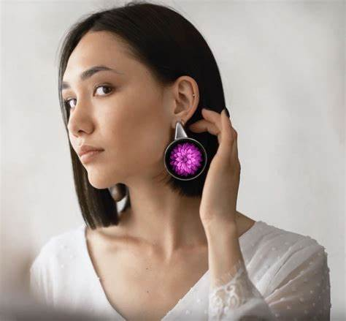
Earrings
– Speakers embedded into these earrings will be the phone’s receiver.
Digital rings often include a small OLED display, which can be used to show notifications, time, or other relevant information. Despite its small size, the display is capable of providing clear and vibrant visuals.

Slide 7
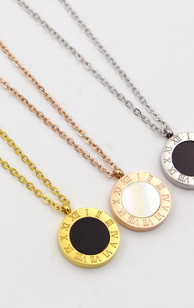
Necklace
Users will talk into the necklace’s microphone receiver.
They transfer the information in the form of signals.

Slide 8

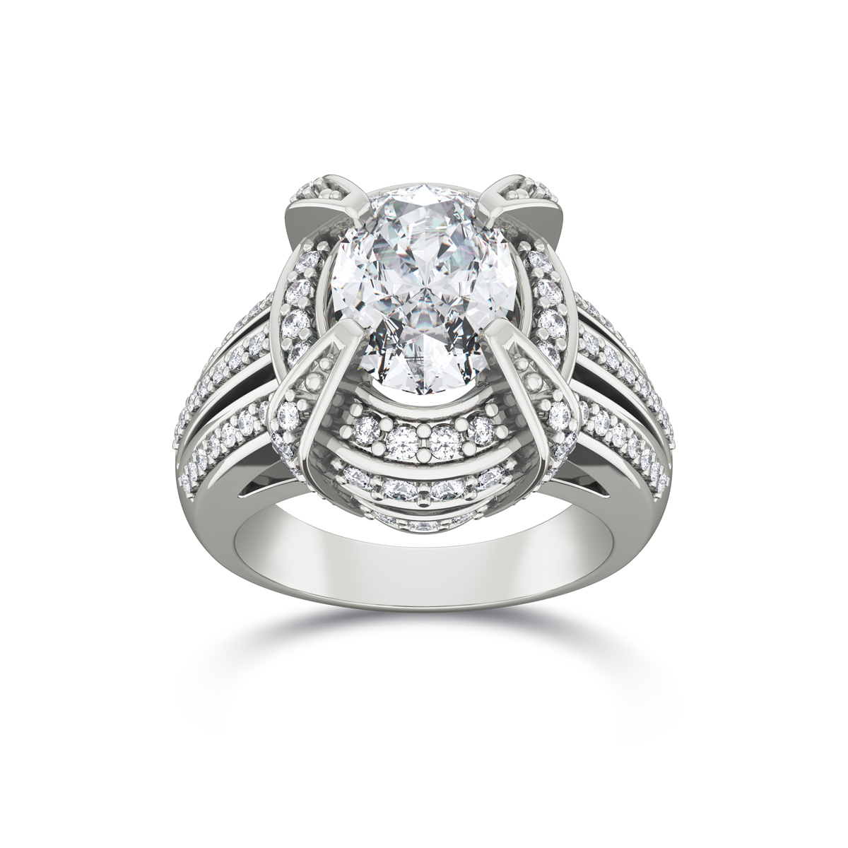
Rings
The ring is equipped with light-emitting diodes that flash to indicates an indicate an incoming call.
It can also be programmed to flash different colors to identify a particular call.

Slide 9
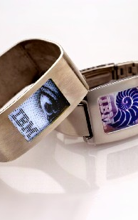
Bracelets
Equipped with a video graphics array (VGA) display, this wrist display could also be used as a caller identifier that flashes the name and phone number of the caller.

Slide 10
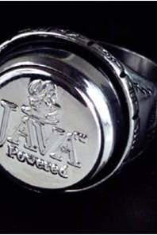
Java ring
The java ring is used for protecting purpose.
It will automatically unlock the doors and log onto the systems.
The java ring is a stainless-steel ring, 16-millimeters (0.6 inches) in diameter, which houses a 1-million-transistor processor, called an ibutton.

Slide 11
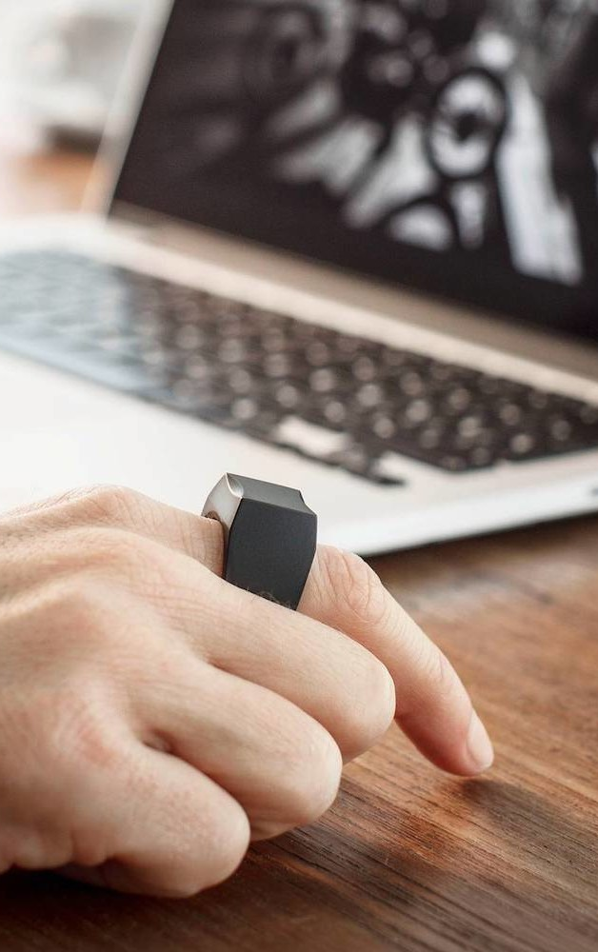
Mouse ring
The mouse-ring that IBM is developing will use the company’s track point technology to wirelessly move the cursor on a computer monitor display.
You’re probably most familiar with track point as the little button embedded in the keyboard of some laptops.
IBM researchers have transferred track point technology to a ring, which looks something like a black pearl ring.

Slide 12
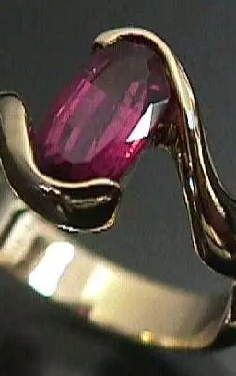
Garnet ring
This ring contains a microprocessor.
It vibrates to let you know that you have received a message from someone.

Slide 13
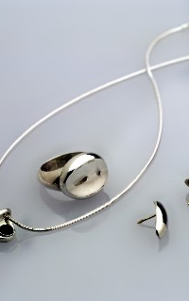
Advantages
Wireless wearable technology.
Easy to carry every where.
It provides security.
Natural interaction with the user.

Slide 14
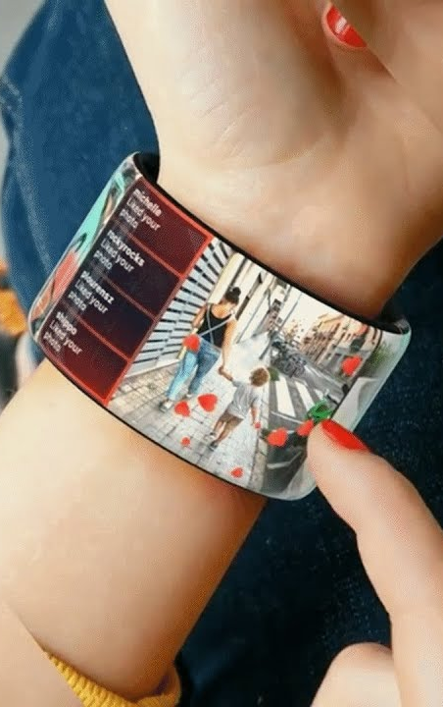
Disadvantages
Display is very small.
Rays may be harmful.
No waterproof so care should be taken.
Very expensive to afford.

Slide 15
Conclusion
The basic idea behind the digital jewellry concept is to have wireless communication and wearable computers
Its hoped to be marketable soon….

Slide 16
Thank you

